Slide 1
Neural Network Example Exercise(s) and Assignment
All responses to assignment questions will be posted on the appropriate slides in this file and then, when complete, uploaded to Moodle.
No PDFs or Emailed responses
Assignment due 2359 on 29 April

Slide 2
Free Software
Students will download EasyNN-plus from
https://easynn-plus.en.softonic.com/
(this is the latest version, the one on easynn.com is 4 years older)
Easiest way is to go to the very bottom and click the download link
(be sure to say no/cancel all the other downloads they want to you make. All you want is EasyNN)
After you download it, install it.
Note: the Help menu item sometimes does not work. This link will take you to the full interactive Help Menu.
http://www.easynn.com/application/EasyNN-plus.htm?mw=MjMw&st=MQ==&sct=MA==&ms=AAA=
Also, there is a 185 page Word and or PDF help document link at easynn.com at the bottom of the page.
(Unless you really want to buy the full version, just download the 30 day trial version.
Yes, I have used both over the last 20 years for different things.)

Slide 3
Run the examples/Samples
Run the sample files, there are a bunch, to get familiar with the software and what it can do.
It will also familiarize you with the NN.
Do this BEFORE you do the actual exercise.

Slide 4
Test
Download the NN exercise.CSV file from Moodle.
Import the CSV file
Build your network from the CSV
Run and Train your network
Put a Screen shot of your network on the next slide
(if you don’t have “screen grabber” software installed, print the network to an Adobe PDF file, then in Adobe use the snapshot tool to lift the image to the clipboard for pasting.)

Slide 5
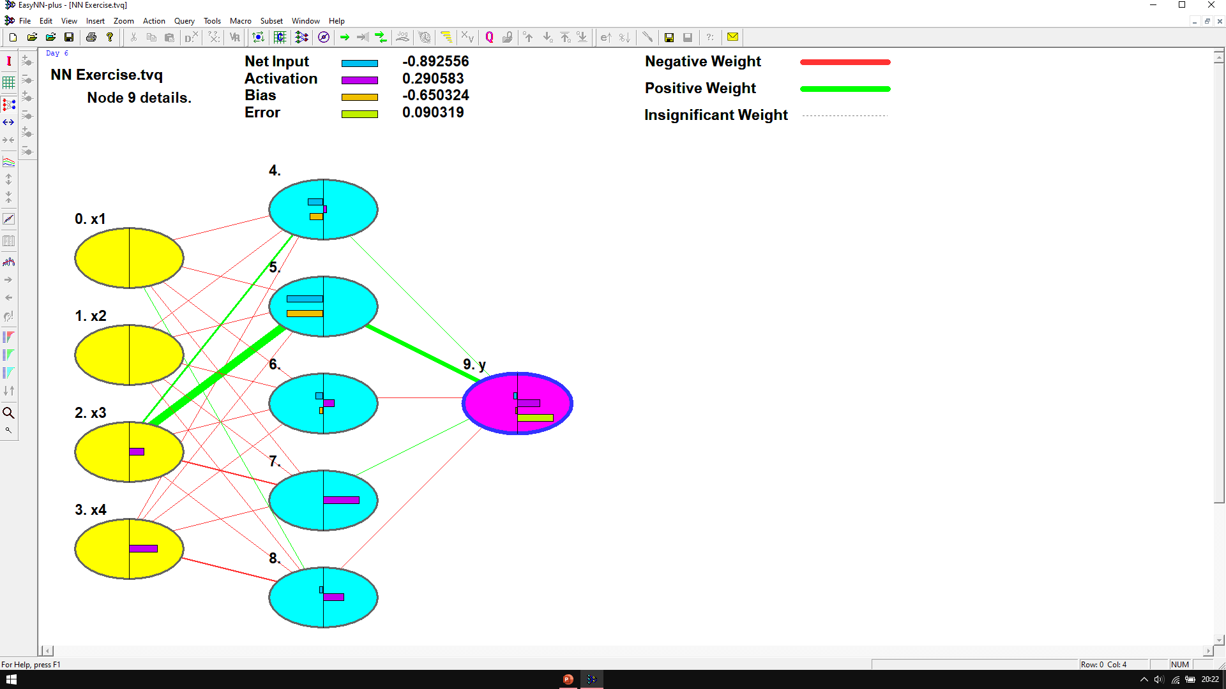
Network Screen shot

Slide 6
Test
Download the Test Data.CSV file from Moodle.
Import the CSV file as an addition to the previous data.
Run and RE - Train your network
Put a Screen shot of your new network on the next slide
(if you don’t have “screen grabber” software installed, print the network to an Adobe PDF file, then in Adobe use the snapshot tool to lift the image to the clipboard for pasting.)

Slide 7
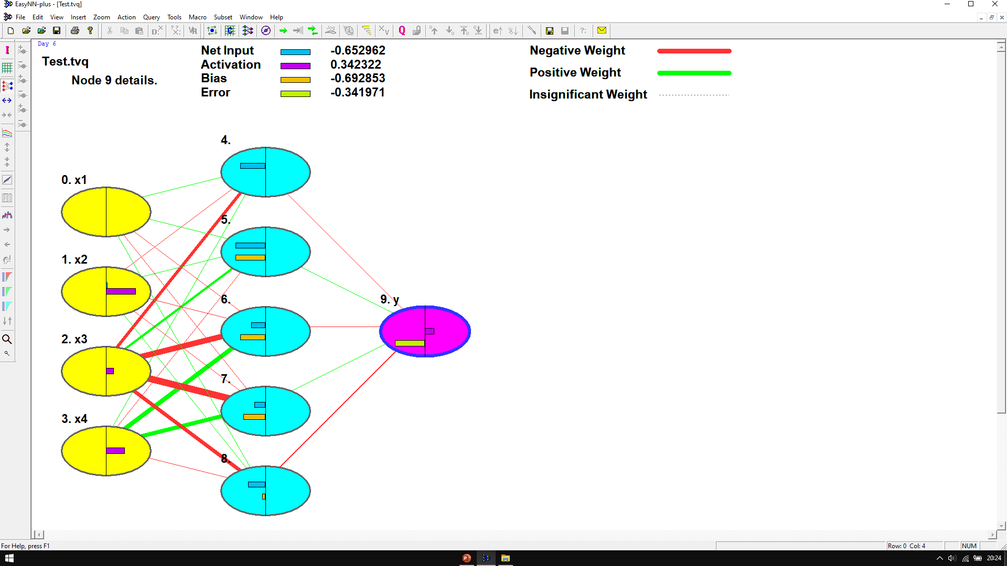
2nd Network Screen shot

Slide 8
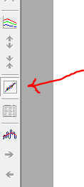
Predictions
After training/running your network
Put a Screen shot of your new network’s VIEW PREDICTIONS page on the next slide.
View Predictions

Slide 9
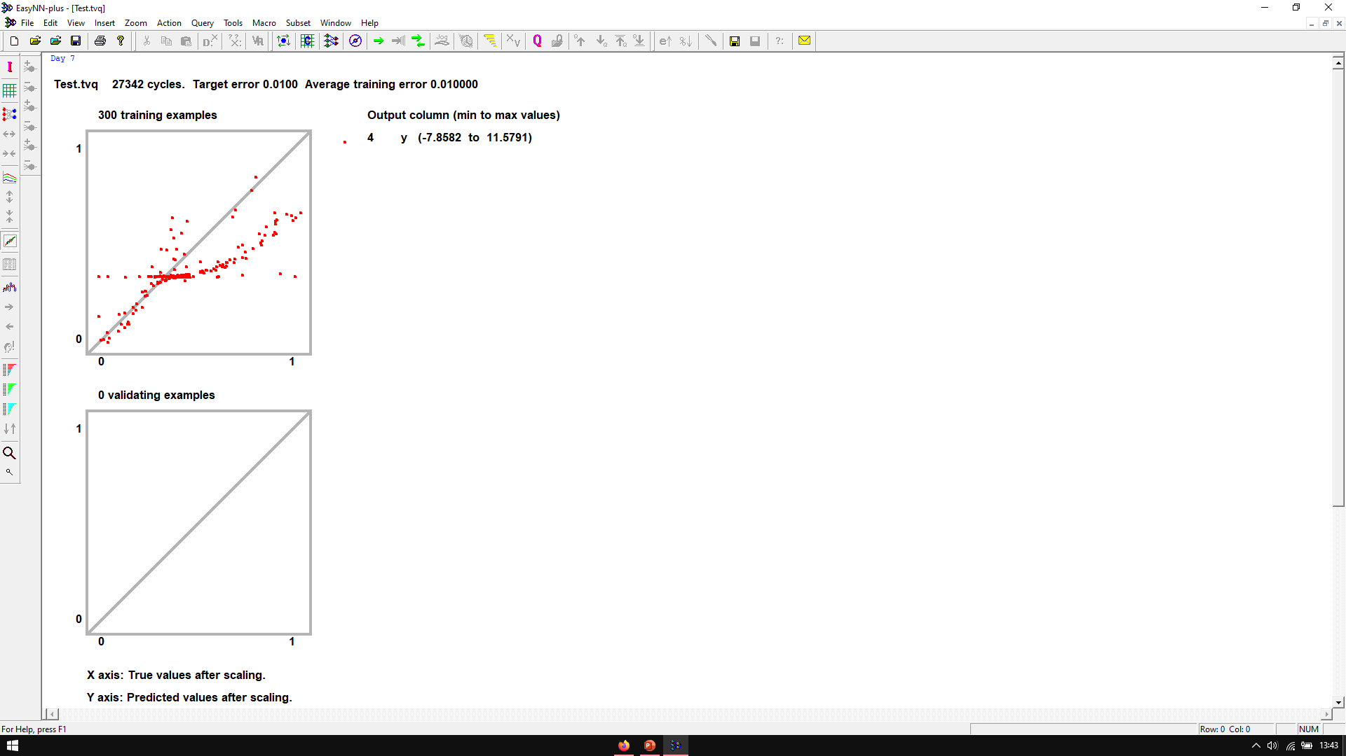
View Predictions Screen shot

Slide 10
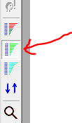
Input Importance
After training/running your network
Put a Screen shot of your new network’s Input Importance page on the next slide.
View Input Importance

Slide 11
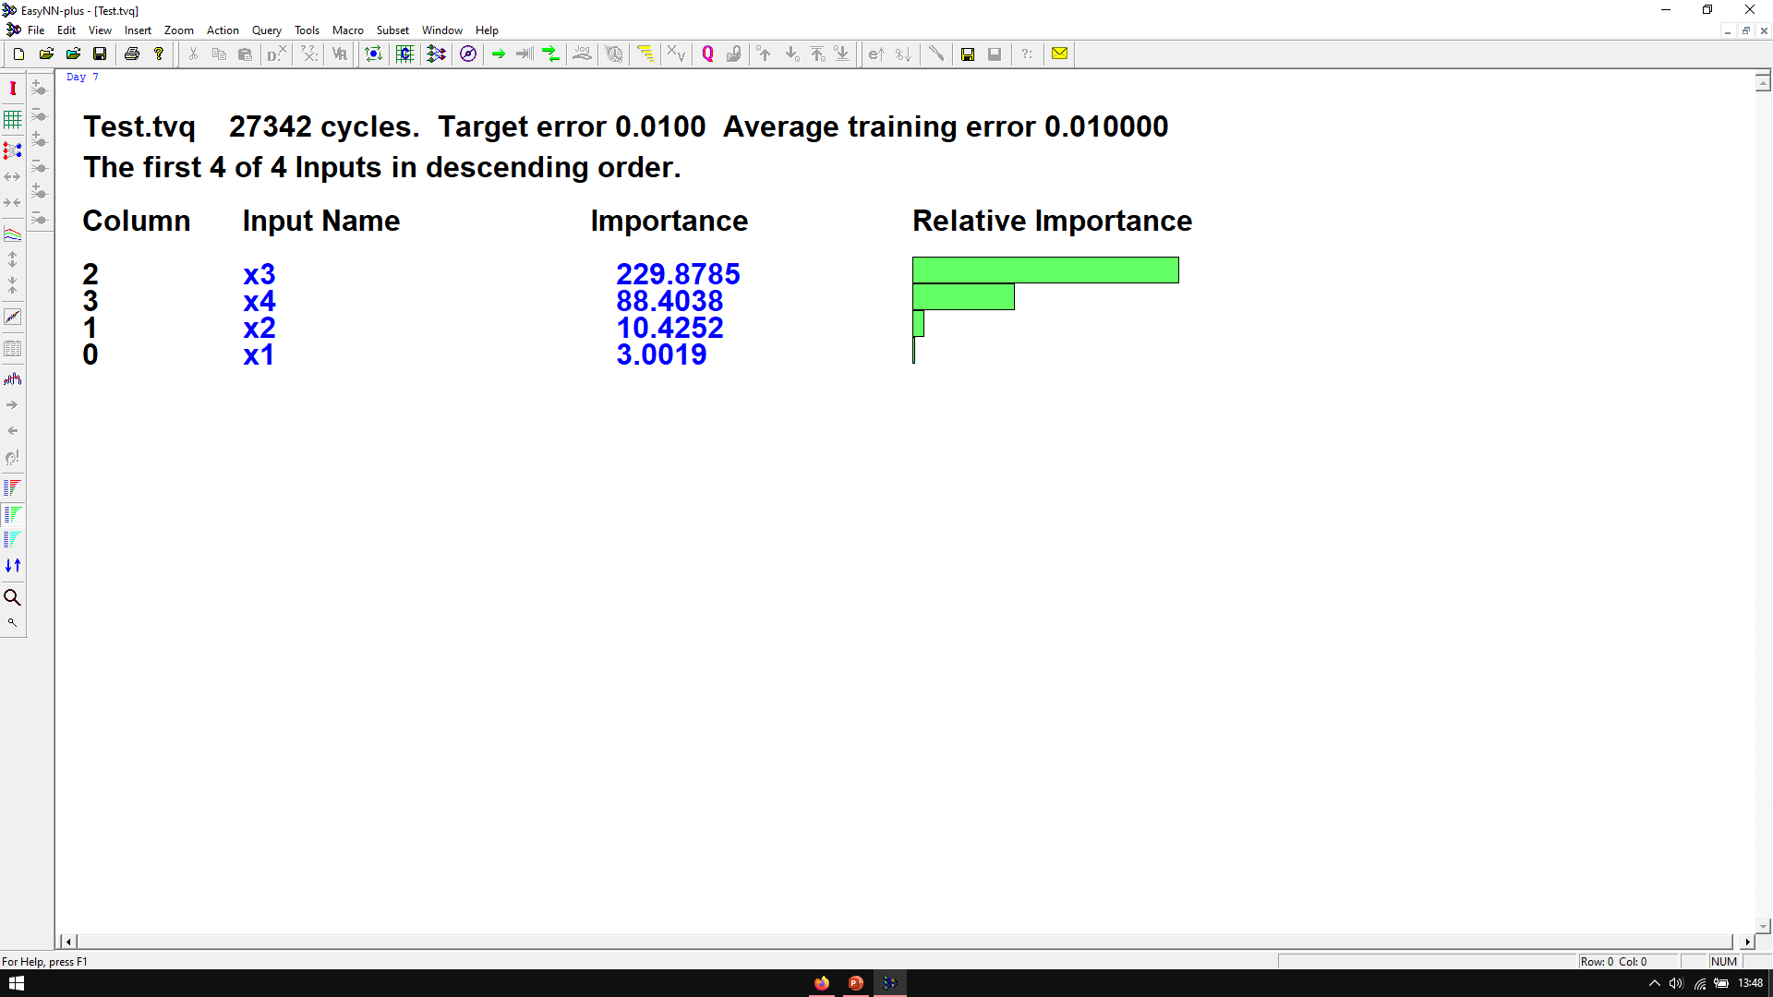
View Input Importance Screen shot

Slide 12

View Sensitivity
After training/running your network
Put a Screen shot of your new network’s Input Sensitivity Analysis page on the next slide.
View Sensitivity Analysis

Slide 13
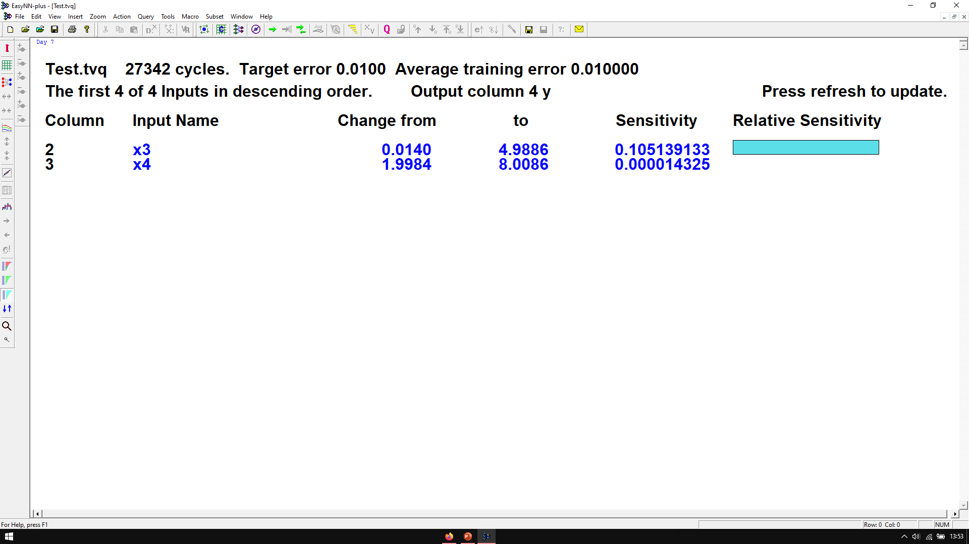
View Sensitivity Analysis Screen shot

Slide 14
Questions:
In Your network:
1. Which Input nodes appeared to have the greatest positive edge weights?
Node x4 had the greatest positive edge weights, followed by node x3.
2. Which node appeared to have no impact?
Node x1 appeared to have the least (no) impact.
3. What can you surmise from looking at the Predictions charts?
From the predictions chart, it can be assumed that the network is fairly accurate, as the majority of dots are close to the central line.
4. Which column has the greatest Input importance?
Column 2 (node x3) had the greatest input importance.

Slide 15
5. Did that match up with Sensitivity Analysis results?
Yes. Node x3 also had the highest sensitivity.
6. Did (4) and(5) match up with (1)?
No. Even though node x4 had the greatest positive edge weights, node x3 had a greater input importance and sensitivity.

Slide 16
Last Question(s)
Use the next slide (and more if you need to) to answer these questions
What surprised you the most from training/running this Network the two times?
What happens when you change the Learning Rate?*
What happens when you change the learning Momentum?*
* Be sure to look any possible changes compared to the screen shots you previously took. Play with these numbers, see if you can the network or network performance to change noticeably.

Slide 17
Use this slide to record your observations from the Final Questions Slide. (copy this slide as many times as you need to.)
The most surprising aspect was the difference in weight positivity/negativity between networks. All that was changed between networks was that fifty more data elements were added; considering that the first network used two-hundred data elements, it did not seem as though the extra fifty would make too much of an impact. The most striking change was in node x3 which went from one light positive weight, one heavy positive weight and three light negative weights to four heavier negative weights and one lighter positive weight. Node x4 also had a very apparent change from five light negative weights to one light and two heavy positive weights and three light negative weights.

Slide 18
Use this slide to record your observations from the Final Questions Slide. (copy this slide as many times as you need to.)
In the first network, decreasing the learning rate from the default value (0.60) results is very little change. Increasing the learning rate has the same effect. Using the optimized learning rate give node x3 a large negative weight into node 7, increases the net input and bias of node 7 and decreases the bias and activation of node y while increasing its error. Increasing/decreasing the learning rate in the second network also results in little change.

Slide 19
Use this slide to record your observations from the Final Questions Slide. (copy this slide as many times as you need to.)
Decreasing the learning momentum in the first network mainly changes several node activations by a small amount. Increasing the momentum results in the same effect. Curiously, the program does not allow the momentum to be greater than 0.90, as it complains that it is too high. In the second network, the only noticeable change when decreasing the learning momentum is a small decrease in the net input of node 5. Increasing momentum has the same result but also removes node x4 from the sensitivity list, most likely meaning that its sensitivity is too small to matter. The program once again complains that the momentum is too high when above 0.90.

Slide 20
Feel free to add any other observations and comments you wish to.
Combinations of high learning rate/low learning momentum and low learning rate/high learning momentum result in almost no changes, aside from a few activations and biases, in both networks. This seems to suggest that they do not affect each other a great deal.

